Slide 1
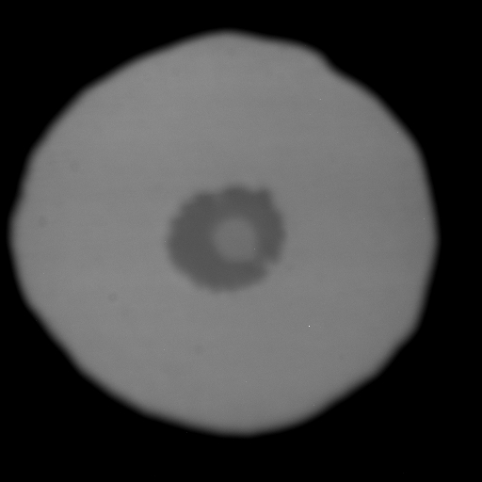
FO75
1 bar
Notes:
FO75 1bar

Slide 2
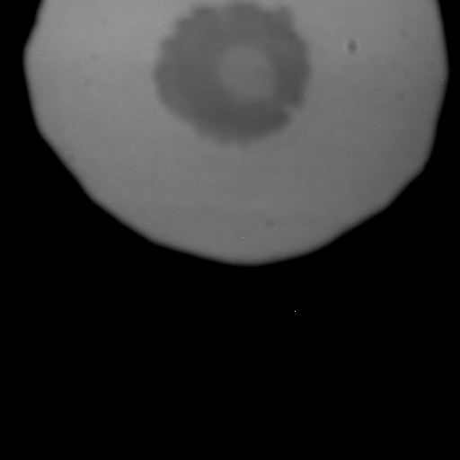
37 GPa
Notes:
37 GPa

Slide 3
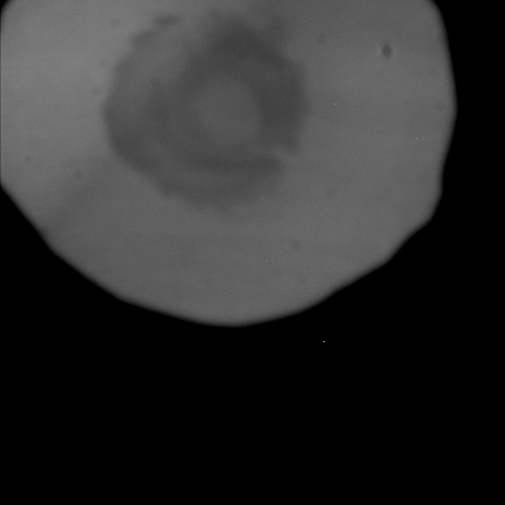
77 GPa
Notes:
77 GPa

Slide 4
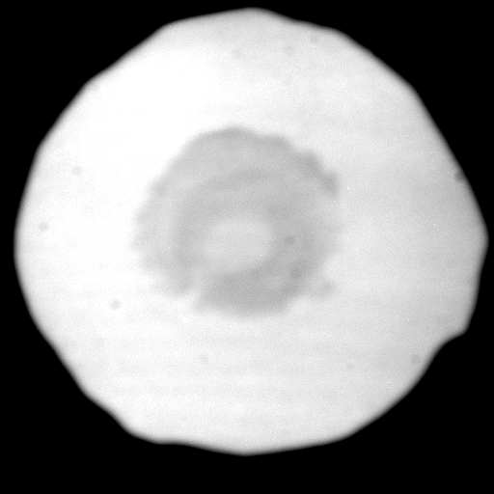
FO75a before heating here
Notes:
FO75a before heating

Slide 5
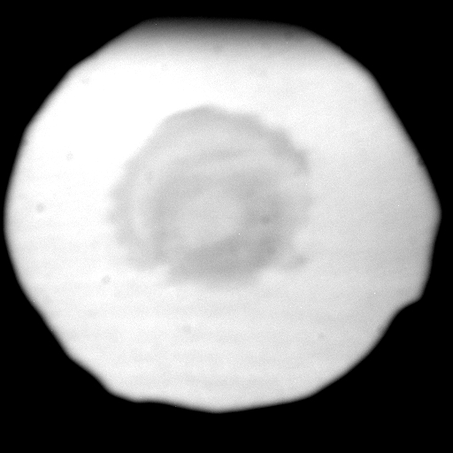
Notes:
1

Slide 6
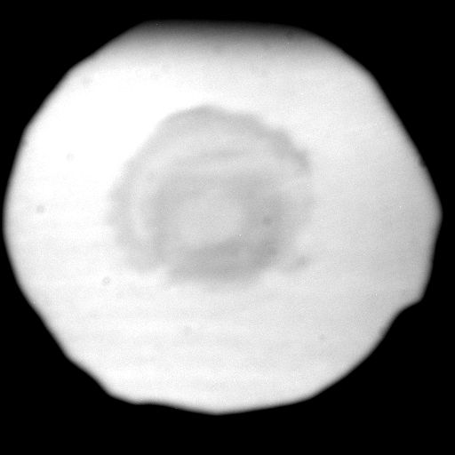
Notes:
2

Slide 7
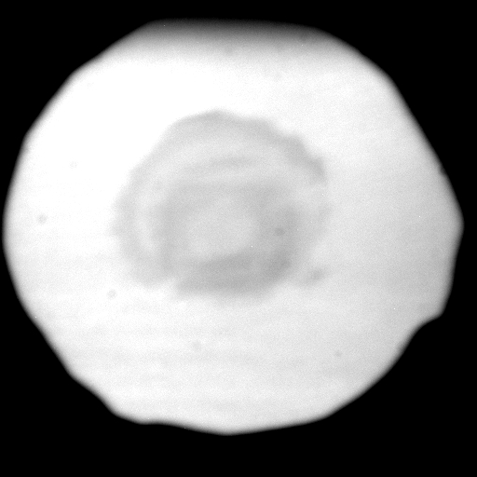
Notes:
3

Slide 8

Notes:
4

Slide 9
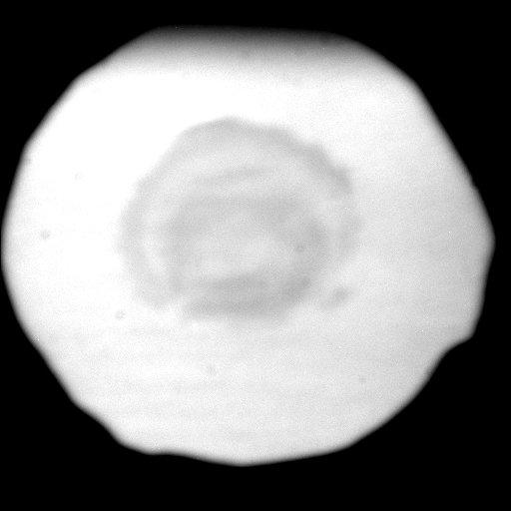
Notes:
5

Slide 10

Notes:
6

Slide 11
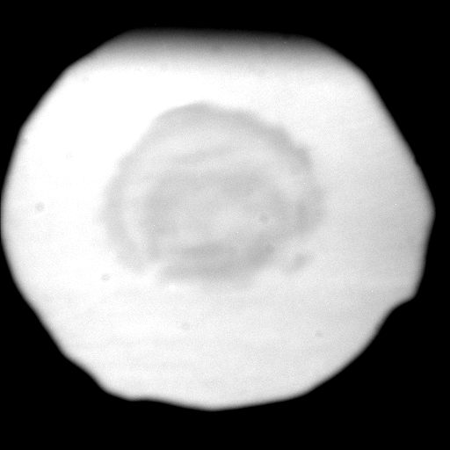
Notes:
7

Slide 12

Notes:
8

Slide 13

Notes:
9

Slide 14
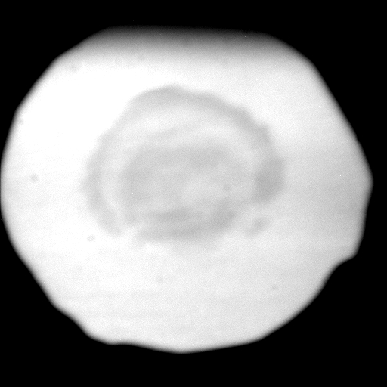
Note that squidge response at 3 o’clock when heating expected at 6 o’clock
Notes:
10

